Slide 1

JAYPEE INSTITUTE OF INFORMATION TECHNOLOGY, NOIDA
MAJOR PROJECT PART II
BUG PRIORITIZATION FRAMEWORK FOR BUG FIXING USING META-HEURISTICS
Under the Guidance Of:
Prof. Chetna Gupta
Team Members:
Kartikeya Consul (9919103183)
Manan Chaudhary (9919103178)
Megha Jain (9919103188)

Slide 2

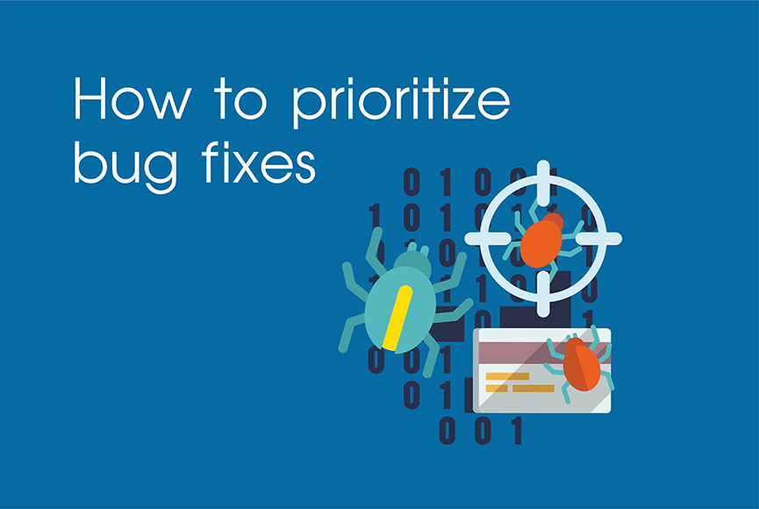

Problem Statement
To develop an automated approach that can accurately and efficiently prioritize the bugs based on their criticality using meta-heuristic algorithms such as Genetic Algorithm and Particle Swarm Optimization.

Slide 3
Introduction
Bug fixing, is an everyday activity in software development and maintenance, which plays a crucial role in software quality assurance (SQA). Bug prioritization is the process of determining the order in which software bugs should be fixed.
The goal is to identify the most critical and impactful bugs that affect the end-users or the functionality of the software system. One way to prioritize bugs is by using metaheuristics.
Metaheuristics are algorithms that are used to solve complex optimization problems. They are often used to find the best solution among a large number of possible solutions. Some common metaheuristic algorithms used for bug prioritization are Genetic Algorithms, Particle Swarm Optimization, and Ant Colony Optimization.
DEPARTMENT OF COMPUTER SCIENCE & ENGINEERING AND INFORMATION TECHNOLOGY (CSE&IT)

Slide 4
Project Objectives
Forecasting of Bug Severity Rating.
Comparison of PSO (Particle Swarm optimisation) and Genetic Algorithm.
Improve Bug Resolution Time
Increase Software Quality
Reduce Costs
Optimize Resource Allocation
Enhance Customer Satisfaction

Slide 5
Literature Review
Alazzam et al., introduces a graph-based feature augmentation approach for enhancing bug triaging systems using machine learning. A new feature augmentation approach that utilizes graph partitioning based on neighbourhood overlap is proposed. It is a quite effective approach for discovering relationships in social graphs. Terms in strong clusters are augmented to the original feature vectors of bug summaries based on the similarity between the terms in each cluster and a bug summary. They employed other techniques such as term frequency, term correlation, and topic modelling to identify latent terms and augment them to the original feature vectors of bug summaries.

Slide 6
Literature Review
Yadav et al., developed a robust algorithm for reducing bug tossing length based on the concept of developer expertise score. Existing bug triage approaches for developer recommendation systems are mainly based on machine learning techniques. These approaches have shown low prediction accuracy and high bug tossing length. This work presented a novel developer recommendation algorithm to rank the developers based on a metric-based integrated score for bug triaging. This integrated score was based on the developer's expertise with an objective to improve bug assignment and reduce the bug tossing length. Such architecture has an application in software bug triaging frameworks.

Slide 7
Workflow
Data Extraction – Data is taken from Bugzilla. The dataset is taken for four bug report datasets, i.e., Firefox, Eclipse, Mozilla Core and Thunderbird. We used Bugzilla filter feature to select the desired columns.
Data Pre-processing – Used python libraries to clean the data and remove null valued columns. Using NLP techniques i.e. tokenization, stemming, stop word removal, etc.
Feature Extraction – TF-IDF (term frequency-inverse document frequency) weighing and laplace smoothing is used for this.
Feature weighting using the PSO and GA algorithms.
Bug prioritization based on severity.

Slide 8
Algorithms Implemented
Particle Swarm Optimisation :-
Optimization algorithm that is inspired by the behaviour of social organisms, such as birds or fish.
Used in various fields, including feature selection and feature reduction.
During the optimization process, each particle moves through the search space to find the best subset of features that maximizes the fitness function.
DEPARTMENT OF COMPUTER SCIENCE & ENGINEERING AND INFORMATION TECHNOLOGY (CSE&IT)

Slide 9
Genetic Algorithm :-
Inspired by the process of natural selection and genetics.
GA can be used for feature reduction by treating the features as genes in a chromosome.
Each chromosome represents a possible subset of features, and its fitness represents the quality of the subset.
GA applies genetic operators such as crossover and mutation to the chromosomes to create new offspring chromosomes.
DEPARTMENT OF COMPUTER SCIENCE & ENGINEERING AND INFORMATION TECHNOLOGY (CSE&IT)

Slide 10
Results
Approaches | Dataset | Performance Measuring Parameters
 |  | Accuracy | Precision | Recall | F-measure
K-neighbour | Mozilla | 77.00 | 63.60 | 77.00 | 69.50
 | Firefox | 57.66 | 54.80 | 57.70 | 49.40
 | Thunderbird | 63.66 | 52.90 | 63.70 | 57.30
 | Eclipse | 72.66 | 65.30 | 72.70 | 68.60
Avg. results of K-Neighbour |  | 67.745 | 59.15 | 67.775 | 61.20
PSO K-neighbour | Mozilla | 81.33 | 72.90 | 81.30 | 74.30
 | Firefox | 66.66 | 59.80 | 66.70 | 57.00
 | Thunderbird | 69.00 | 64.80 | 69.00 | 58.70
 | Eclipse | 79.66 | 72.10 | 79.70 | 74.00
Avg. results of PSO K-Neighbour |  | 74.1625 | 67.40 | 74.175 | 66.00
GA K-neighbour | Mozilla | 80.33 | 80.40 | 80.30 | 73.20
 | Firefox | 67.66 | 69.80 | 67.70 | 58.70
 | Thunderbird | 70.33 | 62.30 | 70.30 | 60.50
 | Eclipse | 80.66 | 76.50 | 80.70 | 74.00
Avg. results of GA K-Neighbour |  | 74.745 | 72.25 | 74.75 | 66.6

Slide 11
Tools & Technologies Used
Bug Tracking System (Bugzilla)
Python Programming Language
Jupyter Notebook
Genetic Algorithm
Particle Swarm Optimization

Slide 12
References (in IEEE Format)
Alazzam, I., Aleroud, A., Al Latifah, Z., & Karabatis, G. (2020). Automatic bug triage in software systems using graph neighborhood relations for feature augmentation. IEEE Transactions on Computational Social Systems, 7(5), 1288-1303.
Yadav, A., Singh, S. K., & Suri, J. S. (2019). Ranking of software developers based on expertise score for bug triaging. Information and Software Technology, 112, 1-17.
Kukkar, A., Lilhore, U. K., Frnda, J., Sandhu, J. K., Das, R. P., Goyal, N., ... & Rezac, F. (2023). ProRE: An ACO-based programmer recommendation model to precisely manage software bugs. Journal of King Saud University-Computer and Information Sciences, 35(1), 483-498.

